Slide 1
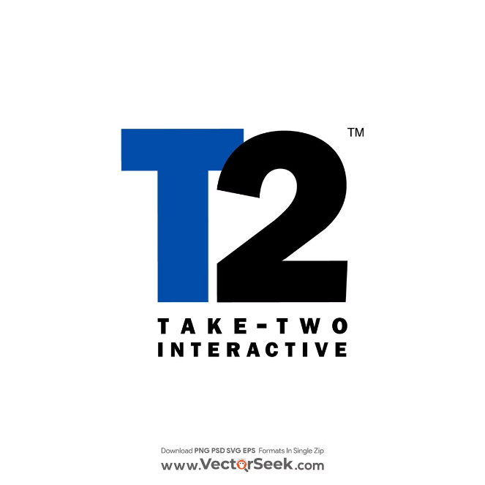
Take-Two Interactive Software: A Gaming Industry Leader
Take-Two Interactive Software, Inc. (NASDAQ: TTWO) stands as a titan in the interactive entertainment industry. Founded in 1993 and headquartered in New York, the company has carved out a significant niche in the gaming world, known for its high-quality, engaging content across multiple platforms. With a current stock price of $151.52 and a market capitalization of $26.52 billion, Take-Two presents an intriguing opportunity for investors looking to capitalize on the burgeoning gaming market. This presentation will delve into the company's business model, financial performance, and future prospects to support our "Buy" recommendation with a target price of $181.82.
by Hajoon Joseph Song

Slide 2
Take-Two's Business Model and Key Labels
Rockstar Games
2K
Private Division & Social Point
Home to blockbuster franchises like Grand Theft Auto and Red Dead Redemption, Rockstar Games is known for its open-world, narrative-driven experiences that push the boundaries of interactive entertainment.
2K publishes popular sports titles such as NBA 2K and WWE 2K, as well as strategy games like Sid Meier's Civilization. This label caters to sports enthusiasts and strategy gamers alike.
Private Division focuses on partnerships with independent developers, while Social Point specializes in free-to-play mobile games, broadening Take-Two's reach across different gaming segments and platforms.

Slide 3
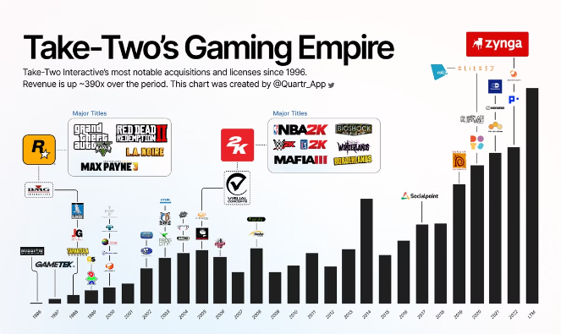
Diverse Product Portfolio
Action/Adventure
Grand Theft Auto, Red Dead Redemption, LA Noire, and Max Payne offer immersive, story-driven experiences that have garnered critical acclaim and commercial success.
Sports
NBA 2K, WWE 2K, and PGA TOUR 2K provide realistic sports simulations, catering to fans of basketball, wrestling, and golf respectively.
Strategy & RPG
Sid Meier's Civilization, XCOM, and Tiny Tina's Wonderlands offer deep, engaging gameplay for strategy and role-playing game enthusiasts.
Mobile Gaming
CSR Racing, Dragon City, Empires & Puzzles, Words With Friends, and Zynga Poker represent Take-Two's strong presence in the mobile gaming market.

Slide 4
Key Leadership and Global Presence
1
Strauss Zelnick - Chairman and CEO
At the helm since 2007, Zelnick has been instrumental in Take-Two's turnaround and growth, steering the company towards its current market-leading position.
2
Karl Slatoff - President
Overseeing day-to-day operations, Slatoff plays a crucial role in executing Take-Two's strategic initiatives and maintaining operational excellence.
3
Lainie Goldstein - Chief Financial Officer
Managing financial strategies, Goldstein ensures Take-Two's fiscal health and supports the company's growth objectives through sound financial planning.
4
Global Reach
While based in the United States, Take-Two has a strong global presence, with primary markets in North America and Europe, and growing penetration in Asia and other regions.

Slide 5
Financial Performance and Market Position
Revenue (Last Fiscal Year)
$5.35 billion
Current Stock Price
$151.52
Market Capitalization
$26.52 billion
Price-to-Earnings (P/E) Ratio
35.24
Price-to-Sales (P/S) Ratio
4.95
Debt-to-Equity Ratio
0.31
Current Ratio
0.65

Slide 6
Valuation and Growth Projections
Revenue Growth
Projected 15% increase in the next fiscal year, reaching approximately $6.15 billion, driven by strong game releases and increasing recurrent consumer spending.
EPS Growth
Expected to grow at a CAGR of 12% over the next five years, reflecting the company's strong franchise portfolio and operational efficiency.
Target Price
Based on DCF model and growth prospects, we arrive at a target price of $181.82 for 2025, representing a 20% upside potential from the current price.

Slide 7
Potential Risks and Mitigation Strategies
1
Delayed Game Releases
2
Increasing Development Costs
Risk: The gaming industry is prone to delays in major releases, potentially impacting short-term financial performance. Mitigation: Take-Two maintains a diverse portfolio across different genres and platforms, helping to stabilize revenue streams even when individual releases are delayed.
Risk: As games become more complex, development costs continue to escalate, potentially pressuring profit margins. Mitigation: The company is investing in mobile and recurrent consumer spending models to create more predictable revenue streams and offset rising development costs.
3
Intense Competition
4
Regulatory Challenges
Risk: The video game industry is highly competitive, with both established players and new entrants vying for market share. Mitigation: Take-Two's strong brand recognition and high-quality content help maintain its competitive edge. The company also continues to invest in new IP and technologies to stay ahead of market trends.
Risk: The gaming industry faces increasing scrutiny over issues like loot boxes and in-game purchases. Mitigation: Take-Two has been proactive in addressing these concerns and adapting its practices to comply with evolving regulations.

Slide 8
Sustainable Competitive Advantages
Valuable IP
Take-Two owns some of the most valuable franchises in gaming, including Grand Theft Auto, providing a strong moat and recurring revenue streams.
Brand Loyalty
The company's reputation for high-quality games fosters strong customer loyalty, ensuring a dedicated fan base for new releases and updates.
Diversified Portfolio
Take-Two's range of games across various genres and platforms reduces risk and provides multiple growth avenues in the dynamic gaming market.

Slide 9
Industry Tailwinds and Growth Opportunities
1
Growing Gaming Market
The global video game market is projected to reach $321 billion by 2026, with a CAGR of 8.94% from 2022 to 2026, providing a robust growth environment for Take-Two.
2
Increasing Engagement
Gaming is becoming more mainstream, with increasing engagement across all demographics, expanding Take-Two's potential customer base.
3
Technological Advancements
New technologies like cloud gaming and virtual reality present growth opportunities for Take-Two to expand its offerings and reach new markets.
4
Strategic Acquisitions
Take-Two's smart acquisitions, such as Zynga, expand its presence in mobile gaming and provide new avenues for growth and revenue diversification.

Slide 10
Investment Recommendation: Buy
Strong Franchise Portfolio
Take-Two's valuable IP and proven revenue generation capability provide a solid foundation for sustained growth and market leadership.
Financial Performance
Consistent revenue growth and strategic positioning in the expanding gaming market indicate strong future performance potential.
Experienced Management
The company's leadership team has a track record of success and navigating industry changes effectively.
Attractive Upside
With a target price of $181.82, representing a 20% upside from the current price, Take-Two offers an appealing opportunity for investors in the interactive entertainment industry.

