Slide 1
SUPER MICRO COMPUTER
Hajoon Song: hjsongjoseph@gmail.com
International School of Beijing, China

Slide 2
General Info/Company Statistics
Market Capitalization | 32.74B
52-Week Range | $80.0~560.49
Price/Revenue | 3.36X
Price/EBITDA | 36.9
Price/Earning | 45.3
Nasdaq: SMCI (Ticker)
Sector: IT Service
Current Price: $579.63 as of 2/2/2024
Target Price: $775.0 (33.8% upside)
Recommendation: BUY

Slide 3
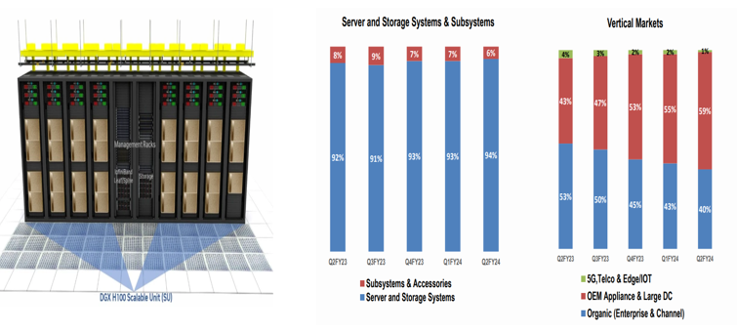
COMPANY OVERVIEW
IT Solutions for hardware and software
AI GPU
Cloud Computing
90% of revenue: Server and Storage System
Increasing numbers of OEM

Slide 4
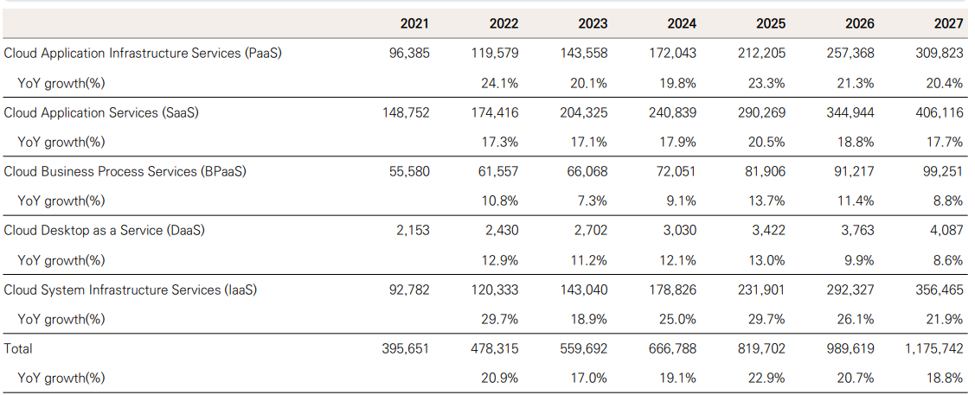
New Cloud Computing Market
Due to the growth of generative AI, cloud computing market will account for a significant amount of IT spending.
Year 2025, and beyond will be characterized by strong SaaS and BPaaS growth, with an increase in generative AI applications

Slide 5
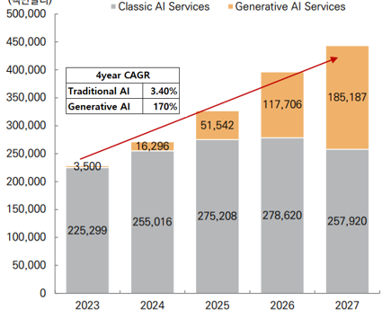
Diversity of Generative AI Usage
Generative AI will comparatively grow with a high CAGR rate and reach into many sectors such as power, education, and transportation.

Slide 6
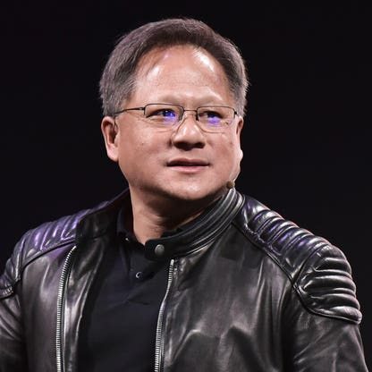
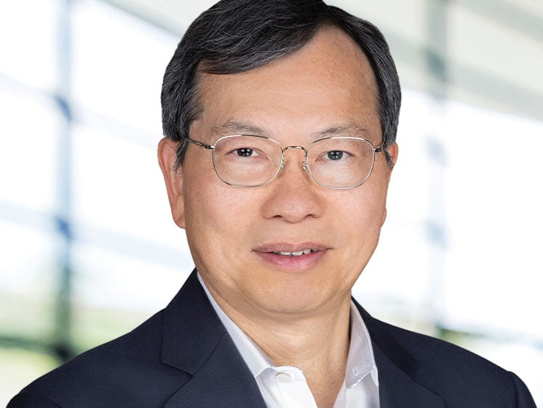
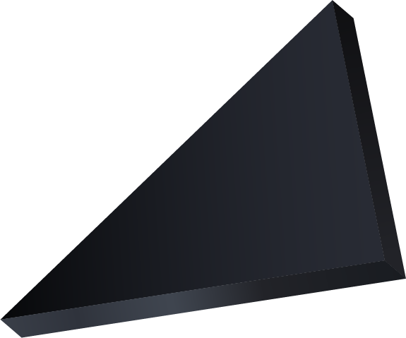
Competitive Positioning
Nvidia CEO Jensen Huang
SMCI has a deep network with Nvidia that brings AI data center server market growth
H100 GPU is not readily available to other industries, but SMCI is due to Nvidia’s support.
Supermicro Computer CEO
Charles Liang

Slide 7
INVESTMENT THESIS
Growth of the AI industry will continue the investment for generative AI companies
AI GPU market is growing
Other companies place GPU orders on Nvidia
SMCI is a Buy Target with a target price of 750$ entailing a 33.8% upside
Growth in the pharmaceutical and bio industry is expected
Nvidia acquisited AI bio drug developers with AI technology
The usage of AI GPU accelerates the combination of AI and bio in the R & D sector

Slide 8
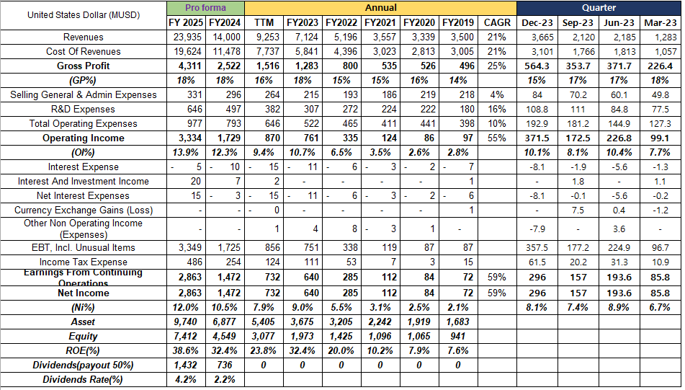
FINANCIAL ANALYSIS
The net profit margin and the ROE increased explosively
Net profit grew 10 times more
Sales volume grew more than 250% of other AI industries
SMCI is likely to pay dividends

Slide 9
Valuation
SMCI’s performance is directly linked to Nvidia.
SMCI’s production capacity is 65% (which is still a high value for the AI GPU production) and plans to increase it.
Sales and the Net Income of SMCI of 2025 will be maximum

Slide 10
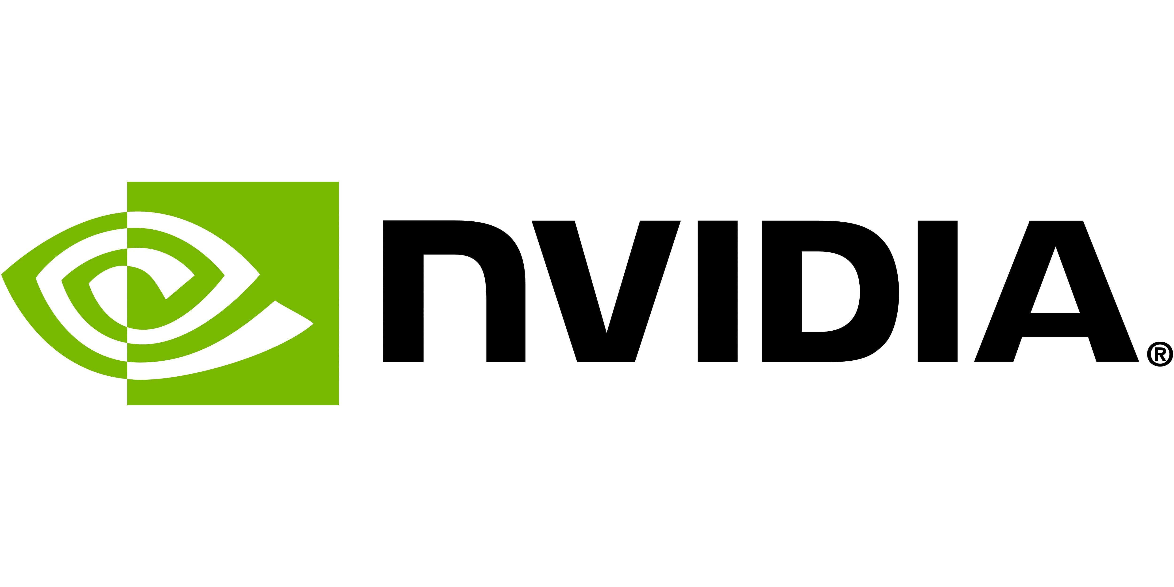
INVESTMENT RISKS
SMCI’s performance is directly linked with the performance with Nvidia. If Nvidia loses AI leadership, revenue decline is inevitable. SMCI is over-relying to Nvidia.

Slide 11
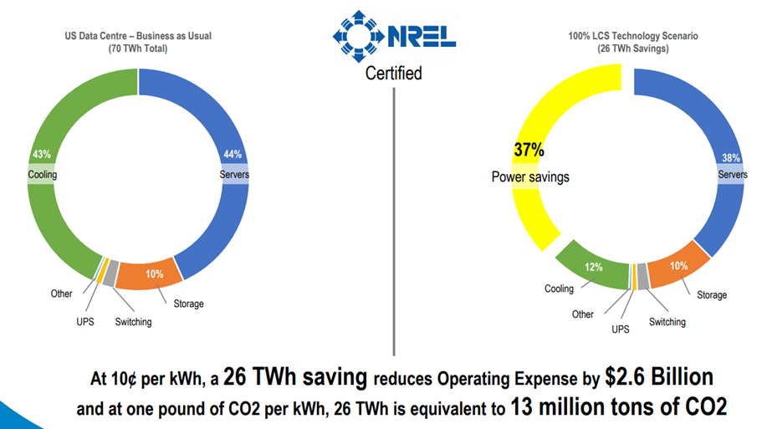
ESG CONSIDERATIONS
43% of computing power is currently used for server cooling, mostly by air-cooling.
Changing air cooling method to liquid cooling, which increases the welfare level of society as a whole, is used by SMCI

Slide 12
3. The company is developing technology with a PUE target of 1.05
4. The company is striving to reduce its total operating costs by more than $10 billion and save energy

Slide 13
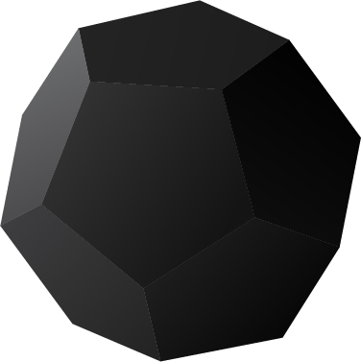
FINAL WORDS
SMCI has a very simple business model, long-standard collaborative relationships with GPU chipmakers, and a high growth rate in the AI industry.
The company is leveraging the same Taiwanese network to dominate the AI server market.
SMCI had made good management decisions to increase ROE through large capital expenditures, rather than resting on its laurels, thereby enhancing shareholder value.

Slide 14
INVESTMENT CHECKLIST
Warren Buffet’s Investment checklist

