Slide 1
Financial Analysis Report for American Water Works (AWK)
Strong Financial Performance and Long-Term Growth Potential

Slide 2
Company Overview & Key Statistics
Company Name: American Water Works Company, Inc. (AWK)
Market Capitalization: $25.37 billion
Revenue (TTM): $4.31 billion
Net Income (TTM): $959.00 million
Shares Outstanding: 194.82 million
EPS (TTM): $4.92
PE Ratio: 26.18
Forward PE: 23.85
Dividend Yield: 2.38%
Current Price: 130.54$

Slide 3
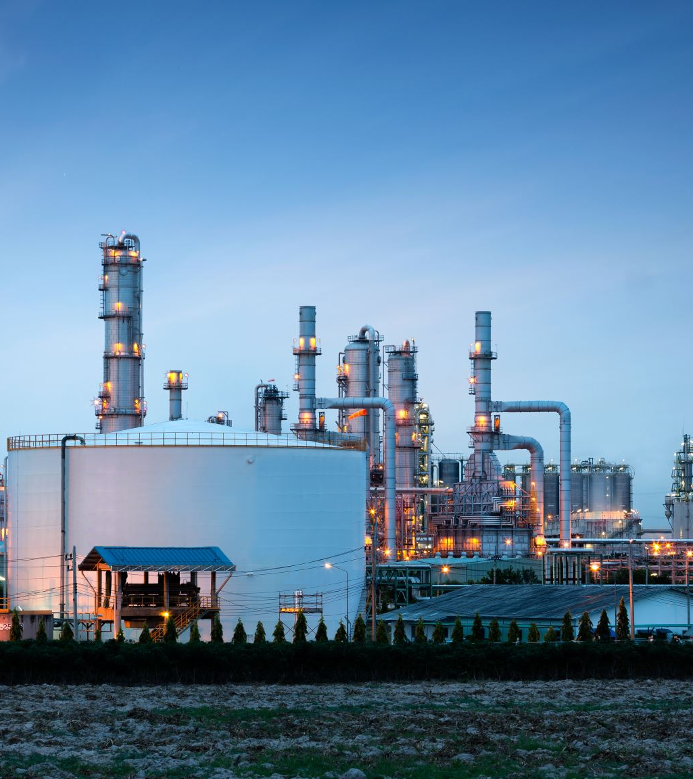
Industry Overview
Utility Industry: Characterized by high regulation, providing a stable environment
Regulated Markets: AWK operates predominantly in regulated markets
Nonregulated Business: Focus on water services for military bases

Slide 4
Investment Thesis
BUY Target:
Target Price of 145.75$, 13.2% increase
Strong Financial Performance: AWK's financial performance supports its valuation
Stable Regulatory Environment: Regulation provides stability for long-term growth
Nonregulated Business: AWK's nonregulated business adds diversification

Slide 5
Financial Performance, Cash Flow and Liquidity
Revenue Growth: Consistent increase in revenue over the past few years
Net Income Growth: Higher revenue and improved operating efficiency drive net income growth
Cash Flow Margin: 14.1%
Current Ratio: 0.85
Quick Ratio: 0.67

Slide 6
Valuation
PE Ratio: 26.18 (slightly higher than industry average)
Forward PE Ratio: 23.85 (lower than industry average)
Dividend Yield: 2.38% (higher than industry average)

Slide 7
Investment Risks & ESG Consideration
Regulatory Risks: Changes in operating environment and financial performance
Competition: Competition from other utility companies and alternative water sources
Environmental Risks: Water scarcity and contamination
Water Conservation: Initiatives to reduce water waste
Sustainability: Initiatives to reduce environmental impact
Community Engagement: Initiatives to engage with customers and communities

Slide 8
Porter’s Five Forces
Threat of New Entrants: Low
Bargaining Power of Suppliers: Low
Bargaining Power of Buyers: Low
Threat of Substitutes: Low
Competitive Rivalry: High

Slide 9
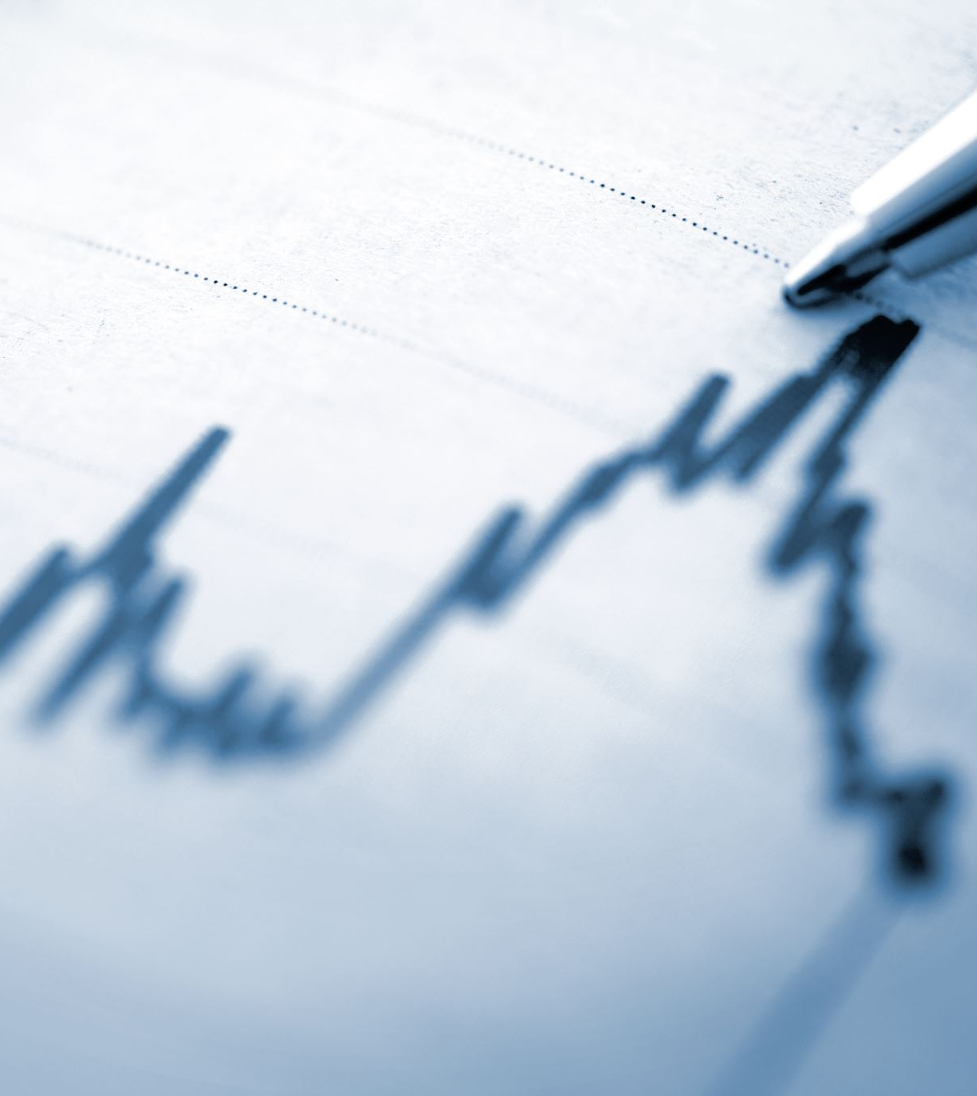
Conclusion
AWK is a well-established utility company with a strong track record of financial performance.
The company's focus on regulated markets and nonregulated business in water services for military bases provides a stable and predictable environment for long-term growth.
AWK's ability to generate cash flows and its commitment to investing in infrastructure replacement and upgrades support its valuation.
The stock's dividend yield and price target suggest that it has potential for long-term appreciation.

Slide 10
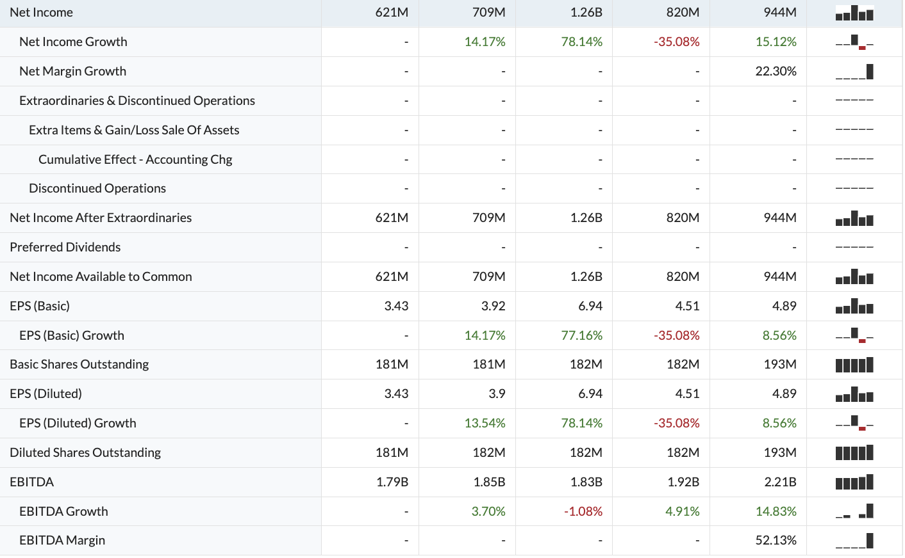
Appendix A: Income Statement

Slide 11
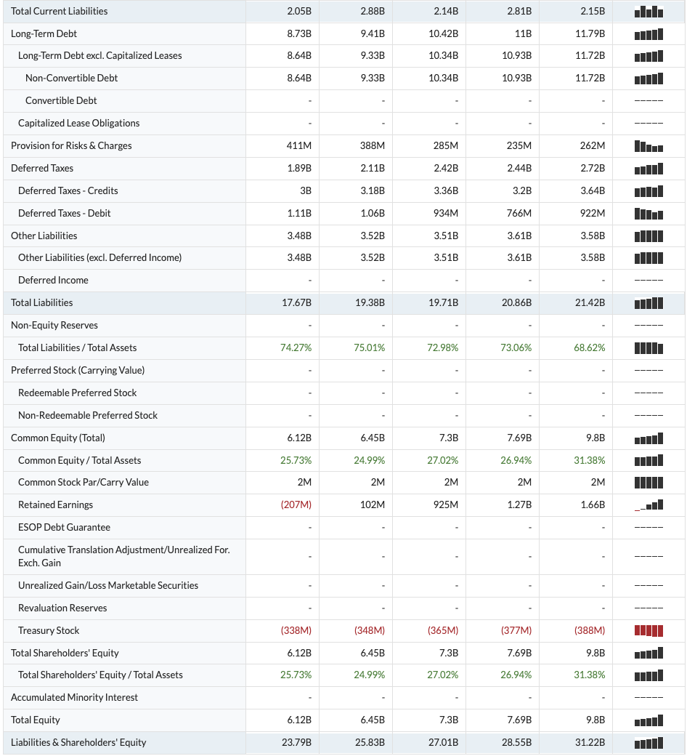
Appendix B: Balance Sheet

Slide 12
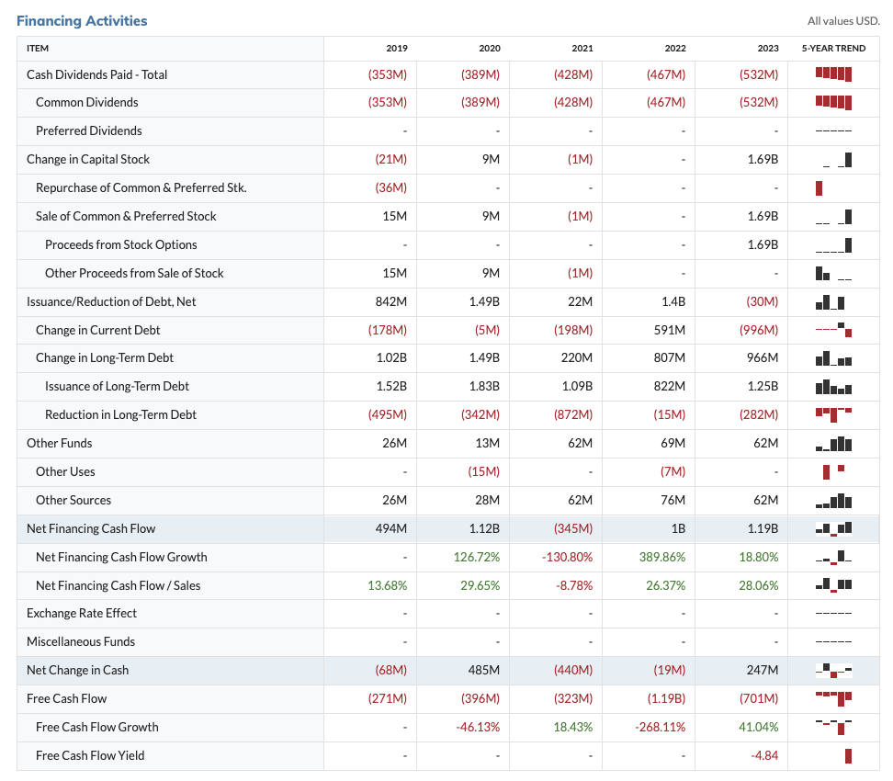
Appendix C: Statement of Cash Flows

